Slide 1
Secure Home Gateway project - Prototype development - IoT security focused - Idea & vision - challenges
Jacques Latour, CTO, CIRA Labs Canadian Internet Registration Authority Jacques.Latour [@] cira.ca September 2018

Slide 2

Today's home network and IoT products and solutions lack secure testing and design. Home network require active monitoring to mitigate the risks of attack.
home network = home and small business network
Notes:
http://www.istockphoto.com/ca/photo/internet-of-things-concept-with-network-of-connected-objects-gm644680544-116869175

Slide 3

The home network of the future must be safe, private, secure and most of all easy to use.
The IETF HOMENET WG is making progress at making it easy to use
Notes:
http://www.istockphoto.com/ca/photo/circular-futuristic-interface-of-smart-home-automation-assistant-virtual-screen-gm637770524-113940363

Slide 4

The Home network must be reachable from the internet seamlessly and securely
IPv6 makes connectivity to the home seamless and visible We must make it secure
Notes:
http://www.istockphoto.com/ca/photo/businessman-touching-a-cloud-connected-to-objects-internet-of-things-gm514785054-88267551

Slide 5

The home network grows to include personal and wearable IoT, inside and outside the home…
Notes:
http://www.istockphoto.com/ca/photo/man-wearing-vr-headset-gm583697902-99848893

Slide 6

Your home network security both internal and external must be protected by using a simple and user friendly model. Typing passwords is a thing of the past.
Notes:
http://www.istockphoto.com/ca/photo/smart-phone-remote-for-smart-home-hologram-technology-concept-gm839028202-137738281

Slide 7

How did we get here?
Our assessment of the home network and IoT security posture post MIRAI attack clearly identified a need for additional home security measures to protect the internet from compromised IoT devices and a very strong need for an enhanced open source home security framework.
Our work so far has identified a significant gaps in open source projects to implement an enhanced home security framework
We embarked on a journey to identify these gaps and start development of many open source projects to better the internet ☺

Slide 8







Secure Home Gateway (SHG) Primary Project Goal
The primary goal of this project is to develop a secure home gateway that;
protects the internet from IoT devices attacks and
protects home IoT devices from the internet attacks
x
x

Slide 9
Scope of Work and Goals
We are developing an advanced security framework for small network (home and small business) gateways based on integrating existing and emerging technologies & standards
Goals:
Develop a functional SHG prototype
Develop a simple management interface to provision complex network
Identify new standards requirements and updates
To enhance small network privacy & security with ‘intent based’ network access controls
To have open source running code & standards
Develop a framework to provision SHG domain names

Slide 10
Why are we working on this? -> Risk mitigation
For many internet organizations like CIRA the #1 risk on the risk register is a large scale (Dyn like) DDoS attack.
One of the mitigation mechanisms for this risk is to prevent ‘weaponization’ of IoT devices
Tightly controlling access ‘to’ and ‘from’ IoT devices inside the home or small office network is key to preventing ‘weaponization’ and causing harm on the internet.
The threat that IoT devices bring is the scale of attacks. The uncontrolled access of million/billions of IoT devices to and from the internet is the threat we need to mitigate.

Slide 11
Overview of the IoT threat landscape -> Scale and capacity
IoT device compromises:
Used in internet attacks i.e. MIRAI/DYN Attack (DDoS) targeting DNS servers (~1.2 Tbs)
IoT traffic generation, reflection and amplification
IoT device used various attacks (DDoS) NTP, DNS, SNMP and new vectors.
IoT device have the capacity to generate large traffic load
Home and small office network now starting to have gigabit internet access speed, significantly impacting the capacity to create powerful attacks

Slide 12



How can we protect IoT devices? -> Common sense
“Don’t even think of connecting an IoT device directly on the internet”
Always place IoT device behind a gateway / firewall
Don’t allow remote access to an IoT device
x
x
IoT Cloud
Services
x

Slide 13


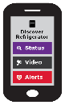
How can we protect IoT devices? -> Best practice & new standards
Rule #1: Identify IoT devices on your home network
Rule #2: Place a policy around the IoT device that restricts it to a specific function (default is no access)
Rule #3: Monitor for behavioural changes in the device and quarantine at the first sign of change.
Home Security
PDAP
Appliances
PDAP
IoT Cloud
Services
Sensors
PDAP
Management
Application
PDAP: Per Device Access Policy

Slide 14



How do we provision new IoT devices? -> Application of emerging standards
The IETF is working on a Manufacturer Usage Description (MUD) specification to help with IoT device provisioning and automated network access control configuration.
https://datatracker.ietf.org/doc/draft-ietf-opsawg-mud
I’m an ACME water sensor
- MUD File at: https://acme.corp/mud/ws1.0.json
MUD FILE:
- I have WIFI & apply the water sensor access policy
- I need to upgrade my firmware at https://acme.corp
- Configure me at https://myip/setup
- Alerts available at https://myip/alerts

Slide 15
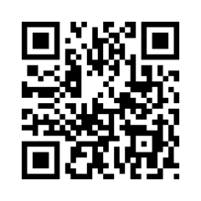
Manufacturer Usage Description (MUD) -> A unique device identifier (label)
The MUD file content would be available on the vendor’s web site (model type and firmware version)
https://acme.corp/mud/water-sensor-1.0.json
The MUD file URL would be available on the IoT device as a QR code or as a network parameter
It would be nice if the IoT device could advertise it’s current firmware version and/or current MUD file URL via WIFI or network connection (DPP, DHCP, LLDP…) on order to setup correct security profile

Slide 16
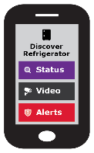



High Level MUD & IoT Device Provisioning Workflow
(1)
SHG
ACME.CORP
MUD
Repository
CIRA SHG
MUD Repository
MUD Supervisor
(3)
User accepts
provisioning
instructions
(2)
Send to
CIRA
(2)
Get vendor
MUD file
SHG
App
MUD Controller
(IP Tables)
(1)
(4)
(4)
IoT device added to network with specific network access controls
Network Access control:
Allow access to ACME.CORP
Allow to send alerts internally
Allow to be configured by app
Deny all other internet access
(1)
Scan MUD
QR code &
send to MUD
controller
MUD QR Code
ACME.CORP
IoT Water Sensor

Slide 17

You guess it! That’s why we need a simple provisioning interface this stuff is complex!

Slide 18
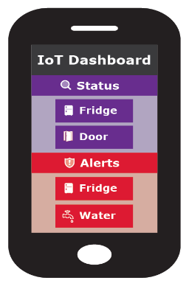
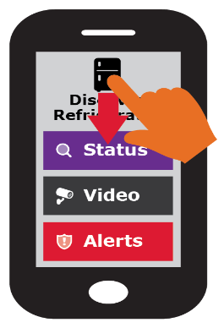
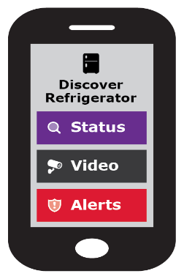







Removing End User Complexity -> Simple user interface
The previous slides have outlined the high level workflow. The actual workflow and automation can be very complex.
One key goal of this project is to present the users with very simple choices to provision and administer a potential complex network.
Ideally, the user can only swipe up, down, left and right.

Slide 19
Quarantine of compromised devices -> Behavioural analysis
The policy part of the MUD profile is created to provide an additional level of protection for the network. This ensures the device will function only as intended and once behavioural changes are noted then the device is logically segregated from the network (quarantine)
x
Appliances
Management
Application
The refrigerator is quarantined
- Bad lettuce ☺

Slide 20
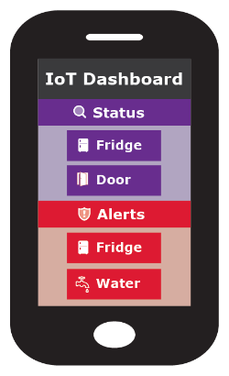



Secure Remote Access -> Trusted authentication & accessible
Removing the complication surrounding enabling trusted secure remote access to home network is a key goal of this project (not for the initial prototype)
Need an internet resolvable domain name for the SHG to remotely connect. i.e. “myhome.ca”
Mobile
myhome.ca
The prototype will use securehomegateway.ca 3rd level domains

Slide 21

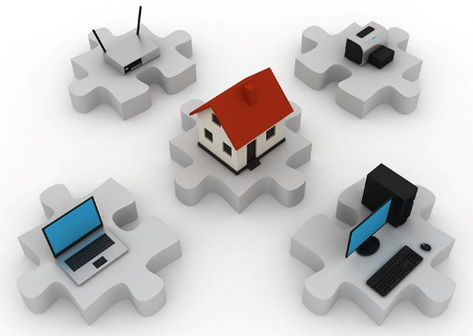
The focus is on Automation
Secure Gateway
Provisioning Automation
Secure Device
Provisioning Automation
+
Innovation
Notes:
http://www.istockphoto.com/ca/photo/home-network-gm117311543-7381629

Slide 22

Step 1 (this is the revised story ☺)
When you buy a CIRA secure home gateway, it comes bundled with a DNSSEC signed 3rd level .CA domain.
+
+
QR Code to activate provisioning and domain)
3rd level domain
domain.securehomegateway.ca

Slide 23
Step 2 – SHG Setup
Follow the configuration instructions
Install & open the CIRA SHG App
Power on the SHG
Scan the SHG QR code for initial setup
System Assigned 3rd level domain name
Setup split view Internet/External DNS for SHG domain
Home Gateway ready for configuration
SHG
Application

Slide 24
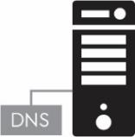
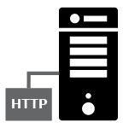

Step 3 – DNS Magic – Work in progress…
Automated DNS Backend Provisioning @ CIRA
CIRA creates the 3rd level .CA SHG domain w/DNSSEC
SHG and CIRA sync on external view propagation, internal SHG DS record synced in external DNS view. (full chain of trust internally and external on SHG domain)
Need synchronisation between external SHG DNS record and SHG external IP address
Internal
DNS view
Secondary DNS
D-Zone
SHG External
IP Address
External
DNS view
Hidden Primary
SHG External
Domain Provisioning
& Primary DNS
? Which one is primary - WIP ?

Slide 25


Step 4 – Current focus is on automated WIFI setup – that’s challenging!
Setup secure home network infrastructure
Using your SHG App, scan the QR code of each new device to:
Discover the MUD profile
Transfer the unique WIFI credentials (per MAC address)
Assign the appropriate Device Access Policy

Slide 26
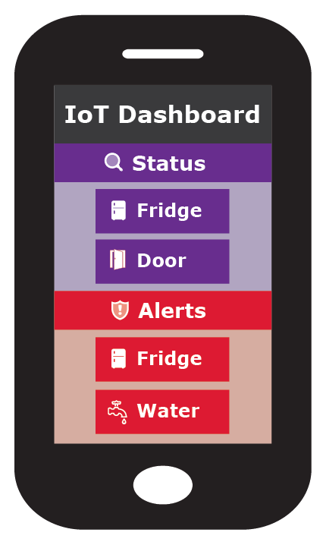
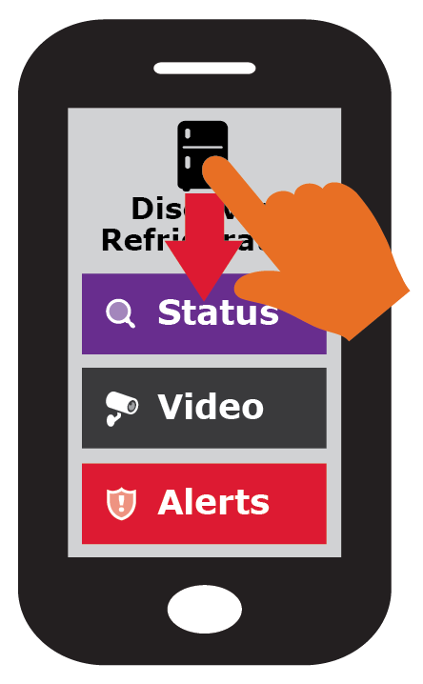
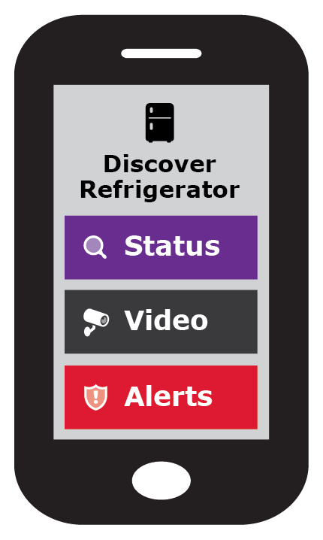





Simple user interface is key to this project: Swipe UP, DOWN, LEFT and RIGHT
Gateway provisioning, device discovery, device provisioning must be as simple as possible, intuitive for non experienced users, available as framework for default open source app.

Slide 27


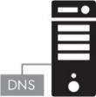


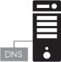
High Level Architecture (very ;-)
Home Network
OpenWrt
Home Gateway
Internal DNS/DNSSEC
External IPSEC
D-Zone firewall
Wifi MiFi Zigbee
NFC RFID
3rdlevel.securehomegateway.ca
Secure Remote Home Network Access
IoT Cloud
Services
&
D-Zone Firewall
CIRA SHG Registry
Primary DNS
D-Zone
3rd Level .CA home domain
Home Gateway
Provisioning

Slide 28
We are building a Prototype -> Based on Omnia Turris Gateway
Develop a Proof of Concept and prototype
Using .CZ Omnia Home Gateway & openWRT
IoT device provisioning based on MUD
Home Gateway App (Android/iPhone)
Develop some IoT discoverable devices and MUD profiles
Use public GitHub to document the functional specification and repo for prototype software
Functional specification (Work in progress)
Open source software repository
https://github.com/CIRALabs/Secure-IoT-Home-Gateway

Slide 29
Specifications we are currently leveraging
Specifications we are leveraging:
https://datatracker.ietf.org/doc/draft-ietf-opsawg-mud/
https://datatracker.ietf.org/doc/draft-ietf-netmod-acl-model
RFC 7368
RFC 8375
https://datatracker.ietf.org/doc/draft-ietf-homenet-simple-naming
https://datatracker.ietf.org/doc/draft-ietf-homenet-front-end-naming-delegation
RFC 4033,4034,4035 (DNSSEC)
https://datatracker.ietf.org/doc/rfc5011/
RFC 4795
Specifications we are planning/considering:
RFC4301, RFC7296 (IPsec. Considering OpenVPN too)
RFC8366, https://datatracker.ietf.org/doc/draft-ietf-anima-bootstrapping-keyinfra/
https://datatracker.ietf.org/doc/draft-cheshire-dnssd-roadmap/
https://datatracker.ietf.org/doc/draft-ietf-dnssd-hybrid/
https://datatracker.ietf.org/doc/draft-cheshire-dnssd-roadmap/
https://datatracker.ietf.org/doc/draft-ietf-dnssd-mdns-relay/
Specifications we are writing:
- draft-richardson-opsawg-securehomegateway-mud-00
How we are using,extending, MUD.
- draft-richardson-anima-smartpledge-00
How we will leverage a DPP-like QR code to do initial enrollment of the *ROUTER*

Slide 30
This slide deck is a vision it’s what we’ll be using In 5 years
Is work in progress, presented as a story
Story how a home gateway can be user and IoT friendly
Is meant to define a security framework and associated standards
IETF, ISO/IEC, others..
Is tuned around implementation at .CA / CIRA, but not specific just for CIRA
Is to solicit feedback
Is another layer of defence (in depth) to protect the internet against nasty (IoT) devices

Slide 31
What do you think?
Project Information
https://github.com/CIRALabs/Secure-IoT-Home-Gateway
Prototype code
https://github.com/CIRALabs/

Slide 32
Roadmap – Future functionality that has been proposed / identified
Next slides things we identified for potential future work or functionality
Includes ideas, comments & feedback

Slide 33








IoT Service / action type -> Generic IoT home controller
Status: Up/down, on/off, ok/bad, status variable
Audio/Video: Camera, video feed
Media: Audio/Video media feed, TV, music
Storage: Data storage, NAS (pictures, files, data)
Alerts: Up/down, on/off, ok/bad, “Water detected”
Control: Turn up/down, on/off, change device value
Cloud Service: IoT vendor, Google, MS, DropBox
VPN (VPN inside vpn.myhouse.ca)
Remote house access
Quarantine, New MUD profile available
Other Sensors/ Actuator functions?

Slide 34

Adding remote VPN access to trusted mobile and computers
Mobile
(2) Grant permission and credentials to mobile for remote home access
(1) Discovery services

Slide 35



Adding your Car to remotely access your home network
Car
(2) Assign roles
Control car feature
View car alerts
(1) Discovery services
View car status/location
Grant permission and credentials to car mobile for remote home access

Slide 36
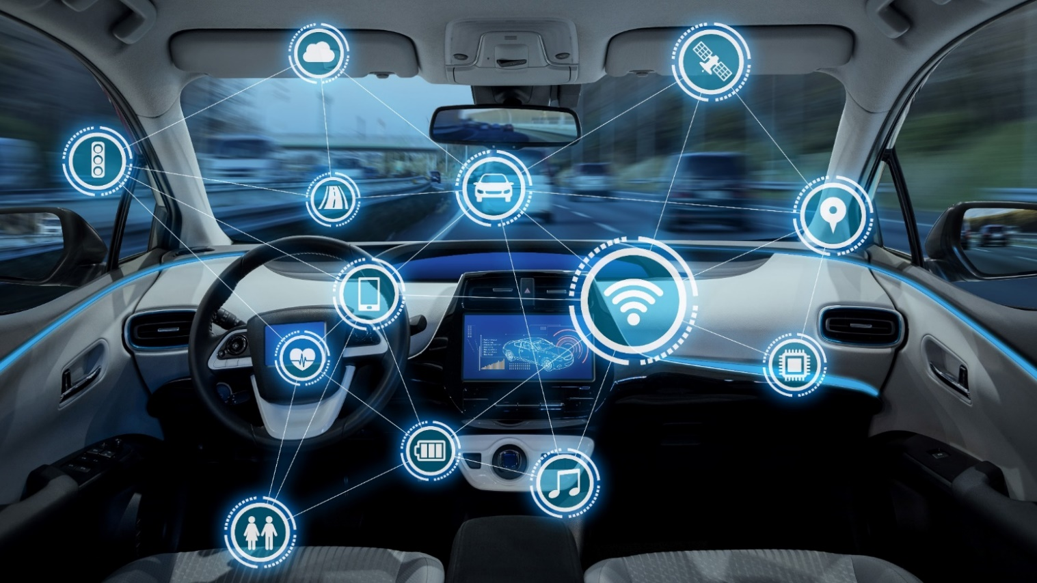
Should the inside of your car should be part of your home network as well?
Notes:
http://www.istockphoto.com/ca/photo/intelligent-vehicle-cockpit-and-wireless-communication-network-concept-gm692837788-127932641

Slide 37
List of IoT scenarios to be assessed
Example of pushing WIFI to the device
Show that the fridge is exposing service
No web interface on IoT device
Focus on cloud / vendor, show they integrate into this solution, can be multi vendor multi cloud provides
IoT Classification: based on device type, air play could see all camera in the house, the TV could see all camera (security controls)
Door bell sends to audio device, you car
Fire alert send to audio receiving device
SmartGRID company allow access to home gateway
allow SmartGRID to access hot water tank
allow SmartGRID to adjust thermostats

